Slide 1
The effect of covid 19 on crime Trend in victoria
Neha, Thelge, Lachlan, Ang

Slide 2
AGENDA
Introduction
Victim Report – Ang
Property and deception - Neha
Family violence - Thelge
Lachlan
Summary

Slide 3
INTRODUCTION

Slide 4
PRIMARY GOALS
Annual revenue growth

Slide 5
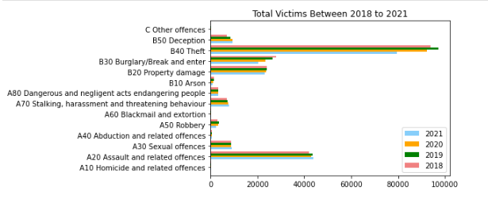
Total victims Between 2018 to 2021
Key founding in from this bar chart:
Through out all Offence Subdivision, Theft had highest number in the last 4 years.
2. There is grow trend in terms of victim reports from 2018 to 2019 for most of Offence Subdivision, but Burglary/Break and Enter

Slide 6
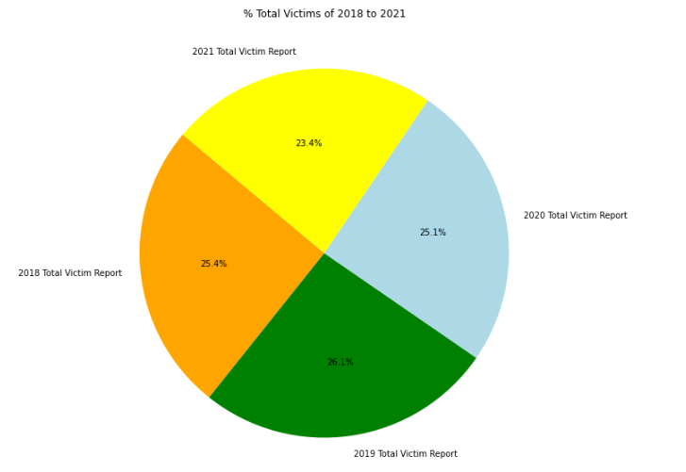
% Total Victims of 2018 to 2021
Key founding in from this pie chart:
2019 had the highest number of contribution in terms of total victims reports
Total victims number was deceasing from 2020 to 2021

Slide 7
BUSINESS OPPORTUNITIES ARE LIKE BUSES. THERE'S ALWAYS ANOTHER ONE COMING.​
Richard Branson

Slide 8




MEET OUR TEAM
TAKUMA HAYASHI
MIRJAM NILSSON
FLORA BERGGREN
RAJESH SANTOSHI
President
Chief Executive Officer
Chief Operations Officer
VP Marketing

Slide 9








MEET OUR TEAM
TAKUMA HAYASHI
MIRJAM NILSSON
RAJESH SANTOSHI
RAJESH SANTOSHI
President
Chief Executive Officer
Chief Operations Officer
VP Marketing
GRAHAM BARNES
ROWAN MURPHY
ELIZABETH MOORE
ROBIN KLINE
VP Product
SEO Strategist
Product Designer
Content Developer

Slide 10
PLAN FOR PRODUCT LAUNCH
Deploy strategic networks with compelling e-business needs
PLANNING
Synergize scalable e-commerce
MARKETING
Disseminate standardized metrics
DESIGN
Coordinate e-business applications
Foster holistically superior methodologies
LAUNCH
STRATEGY

Slide 11
TIMELINE
Q1
Synergize scalable e-commerce
Q2
Coordinate e-business applications
Q3
Deploy strategic networks with compelling e-business needs
Q4
Disseminate standardized metrics

Slide 12
AREAS OF FOCUS
B2B MARKET SCENARIOS
CLOUD-BASED OPPORTUNITIES
Develop winning strategies to keep ahead of the competition
​Capitalize on low hanging fruit to identify a ballpark value
​Visualize customer directed convergence​
Iterative approaches to corporate strategy
​Establish a management framework from the inside​

Slide 13
HOW WE GET THERE
ROI
NICHE MARKETS
SUPPLY CHAINS
Envision multimedia-based expertise and cross-media growth strategies​
​Engage worldwide methodologies with web-enabled technologies​
Pursue scalable customer service through sustainable strategies​
Engage top-line web services with cutting-edge deliverables​​​
Cultivate one-to-one customer service with robust ideas​
Maximize timely deliverables for real-time schemas​

Slide 14
SUMMARY
At Contoso, we believe in giving 110%. By using our next-generation data architecture, we help organizations virtually manage agile workflows. We thrive because of our market knowledge and great team behind our product. As our CEO says, "Efficiencies will come from proactively transforming how we do business."​

Slide 15
THANK YOU
Mirjam Nilsson
mirjam@contoso.com
www.contoso.com

